Slide 1
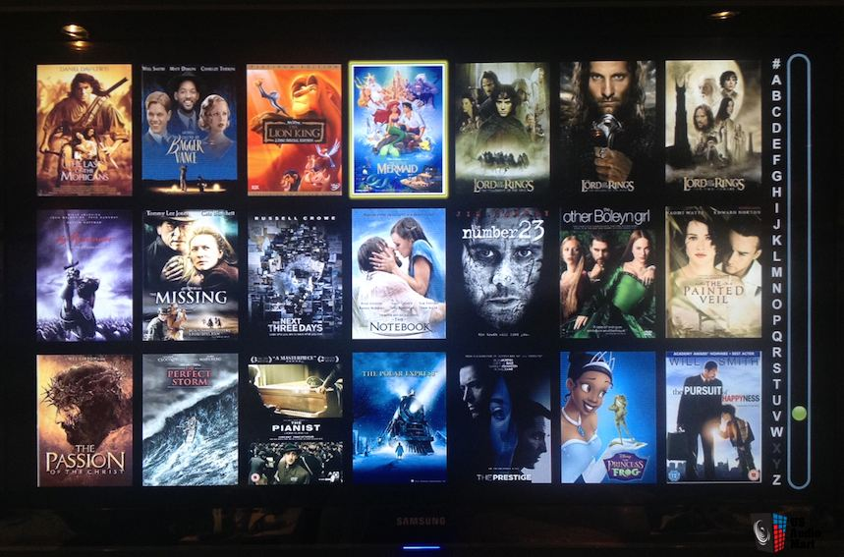
Data Science: Analysis of 5.000 Movies
Capstone Project - The Battle of Neighborhoods (Week 2) - FINAL PROJECT

Slide 2
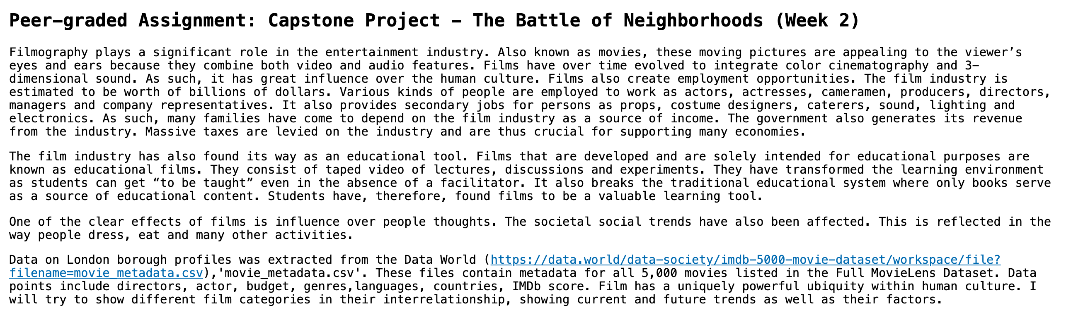
About project - Movie Data

Slide 3
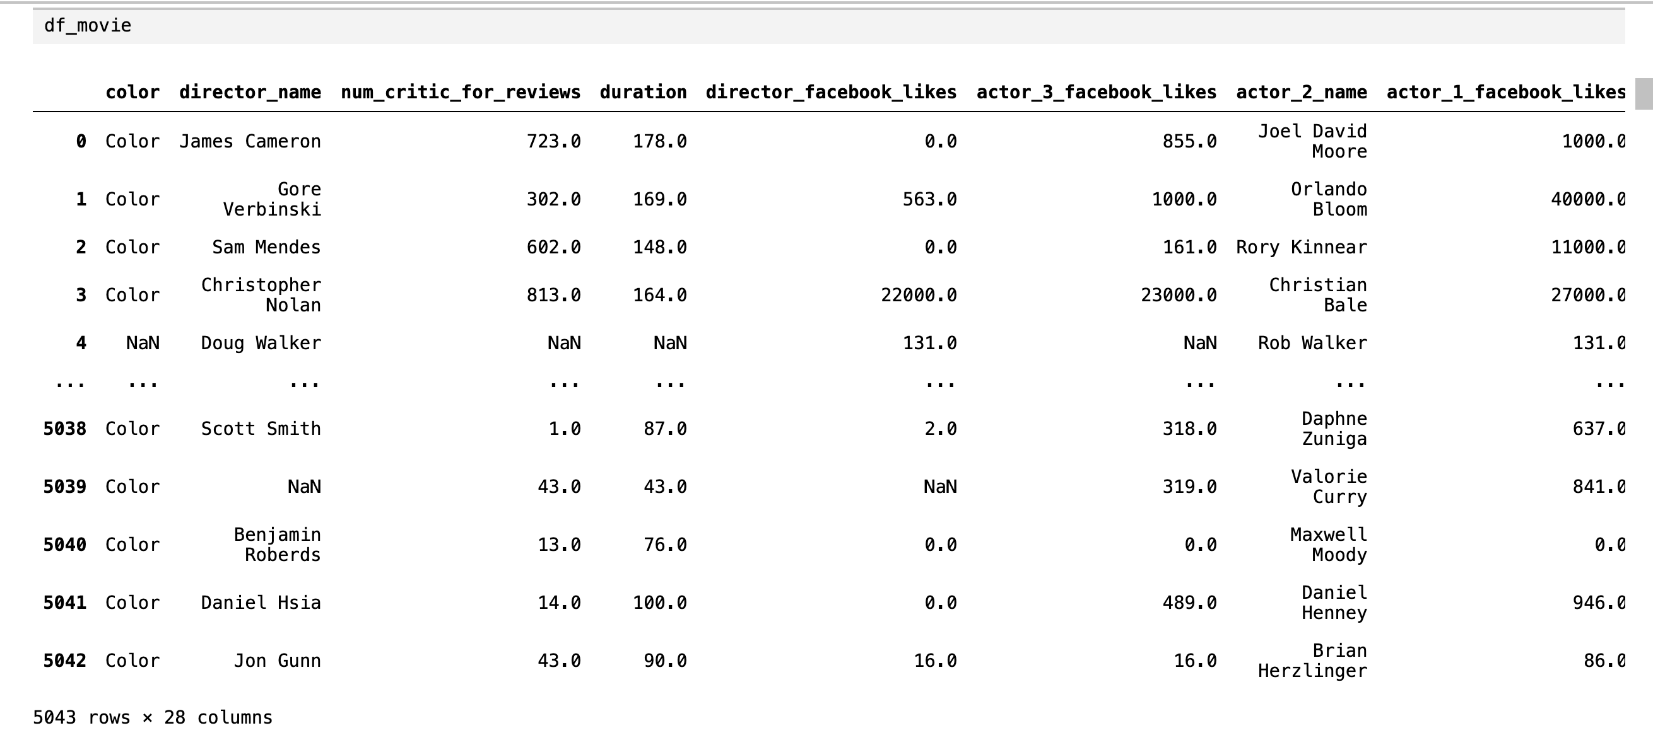

Slide 4
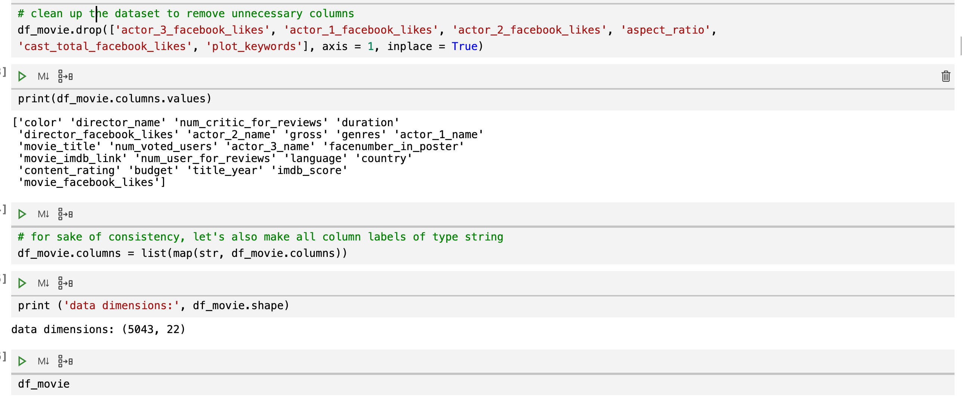
Cleaning and preparing dataset

Slide 5
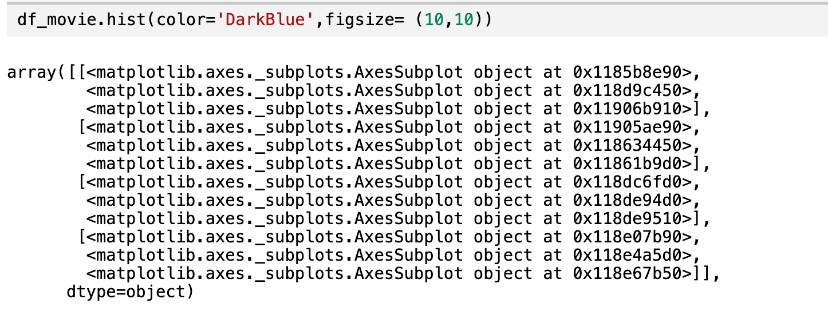

Slide 6
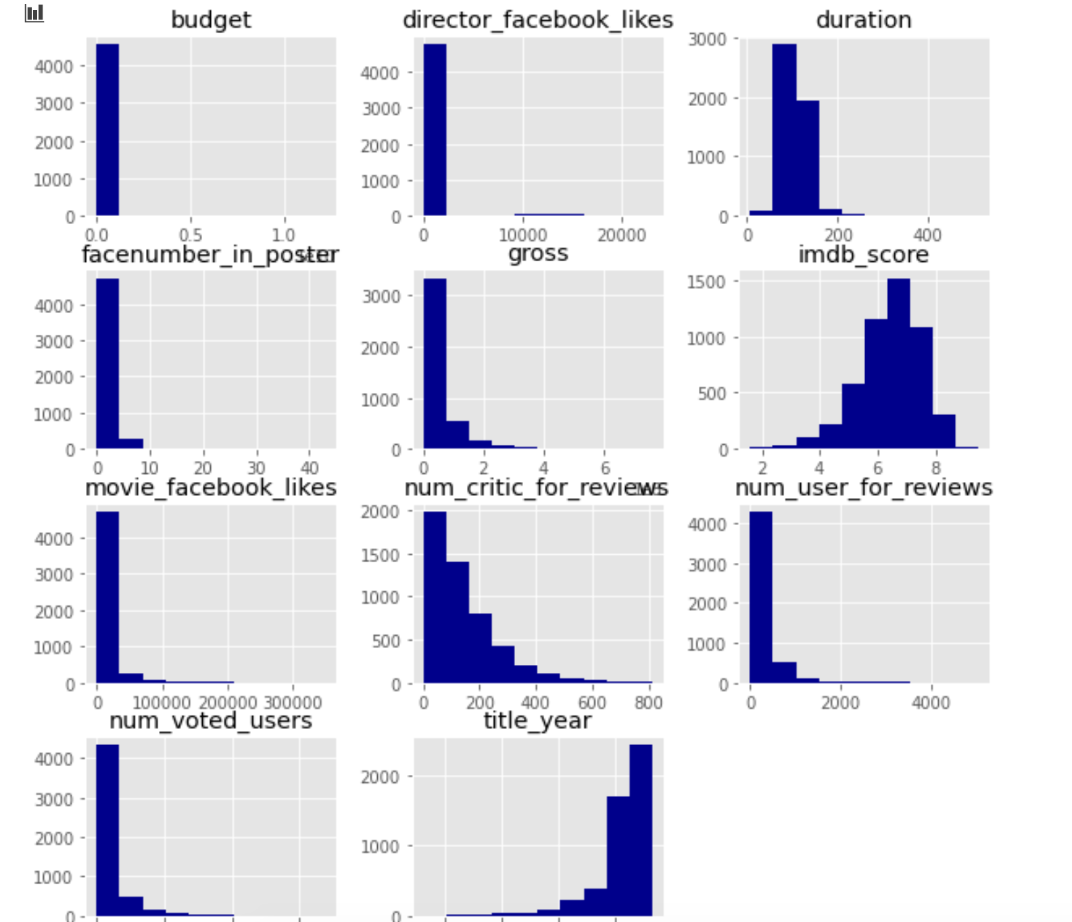

Slide 7
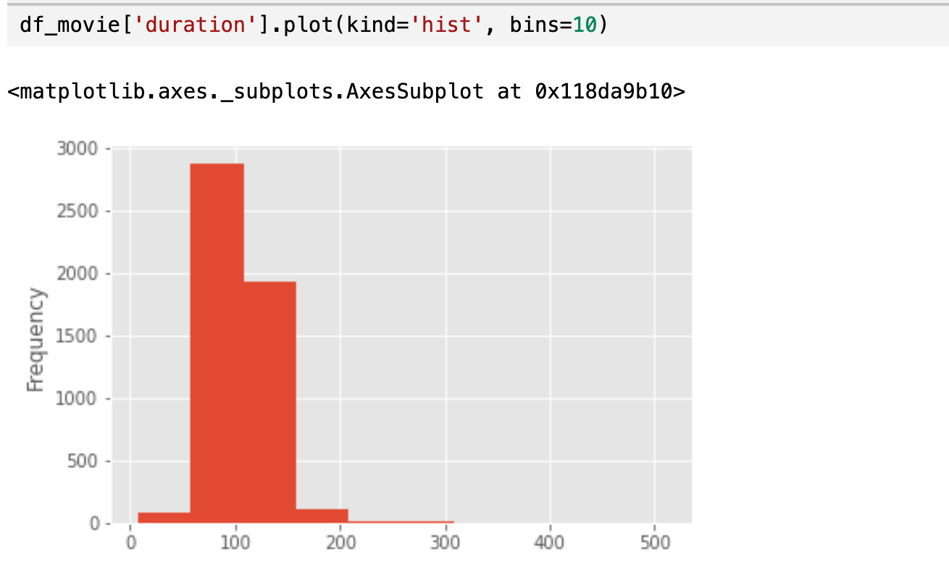

Create a histogram of duration, choosing an “appropriate” number of bins

Slide 8
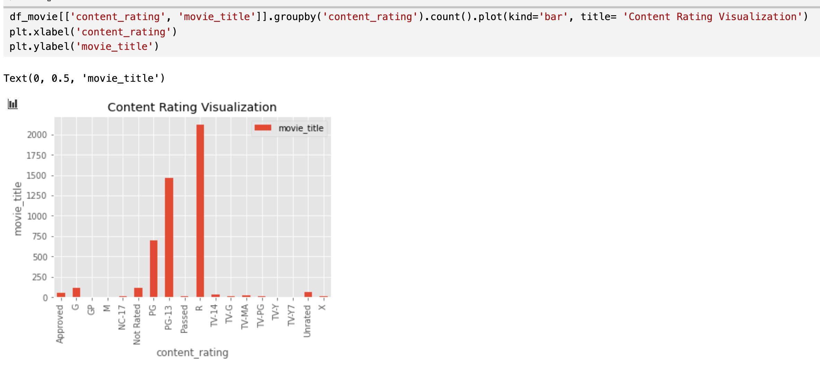
Use a visualization to display that countent rating, including a title and x and y labels

Slide 9
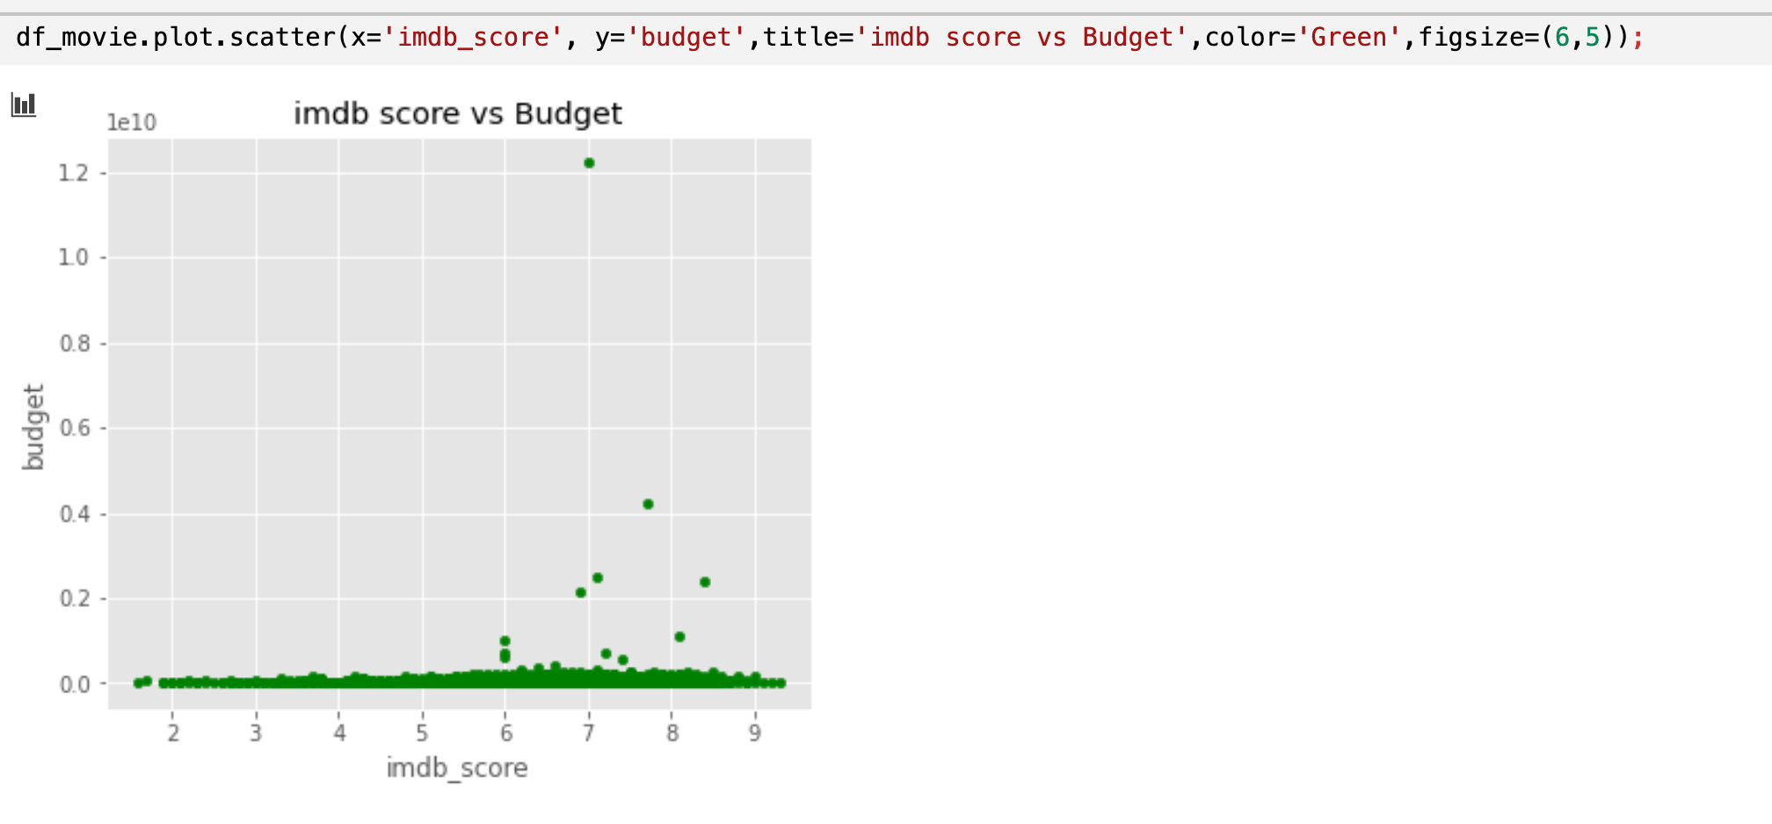

Slide 10
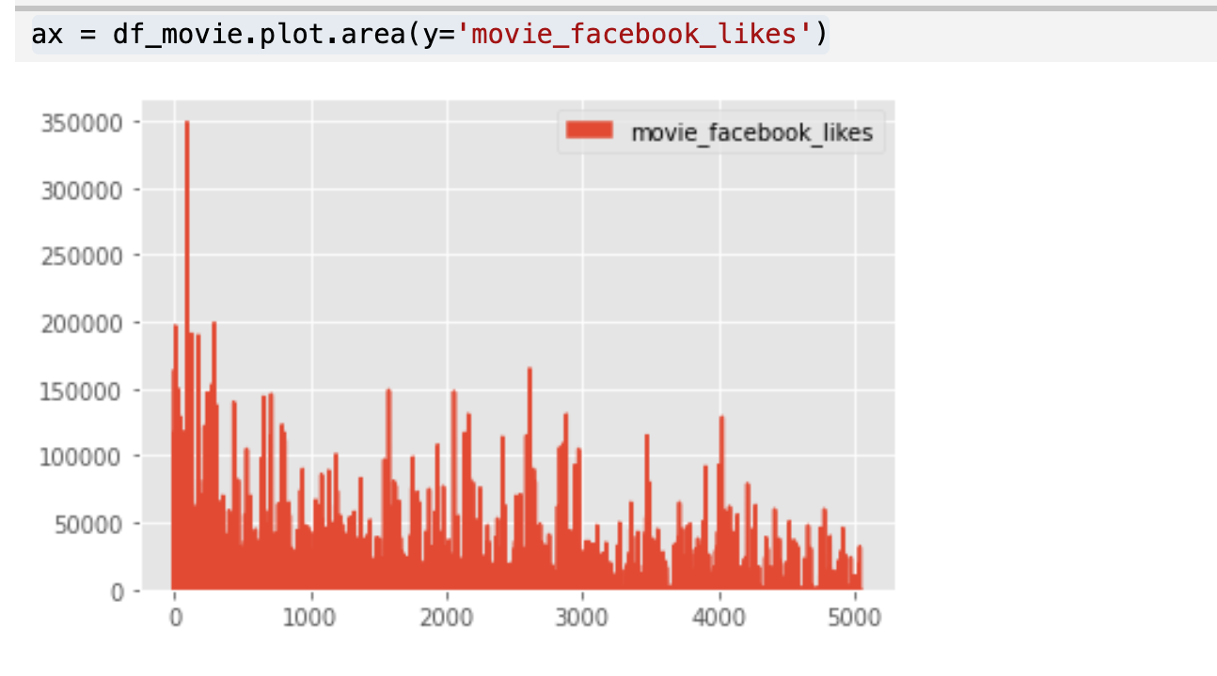


Slide 11
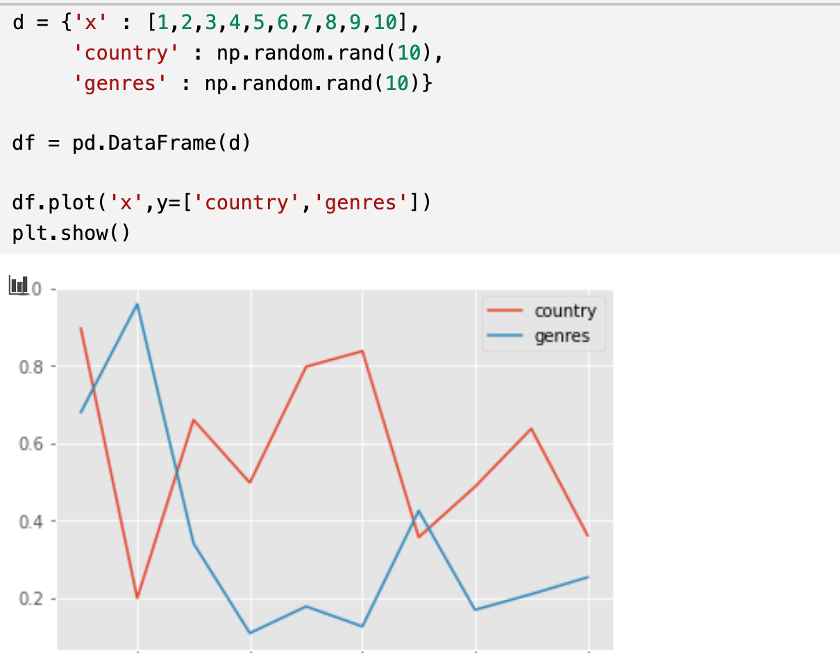
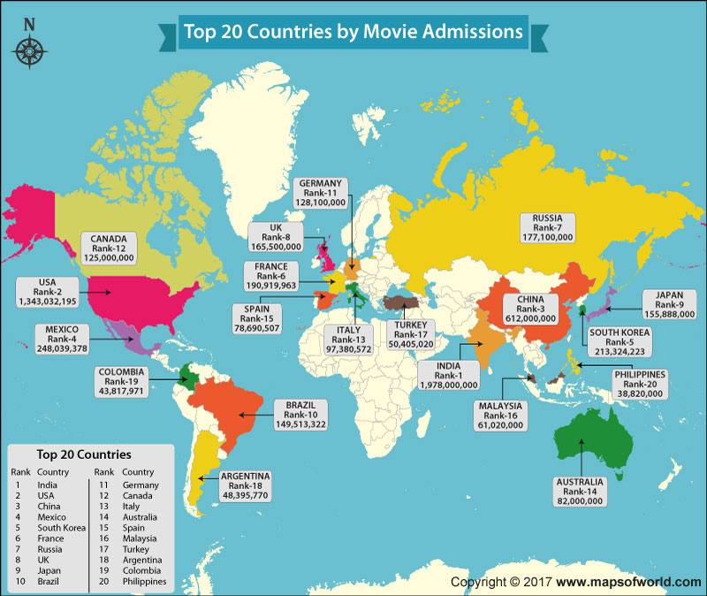

Slide 12
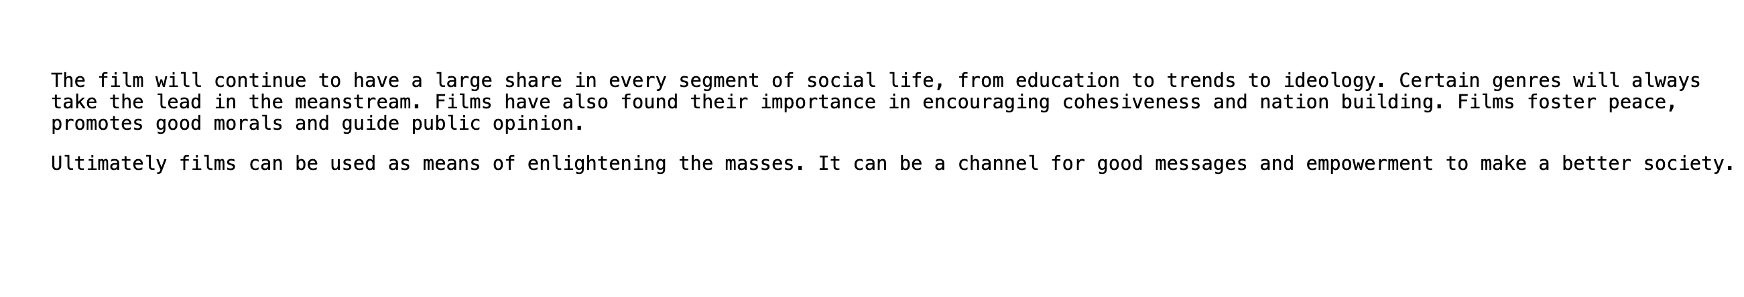
CONCLUSION

